Slide 1

University App 🎓 (System Design)
Prepared by Ihor Melashchenko (C00290950), Software Development, Year 4
Notes:
Good morning.
My name is Ihor Melashchenko, and I am a final-year Software Development student at SETU.
Today, I will be presenting the system design of my final-year project — the University App (please note that the name is not yet finalized and might change in the future), and its current development status.
For context, the University App is an all-in-one application, often referred to as a super-app, which allows students to interact with university facilities through a single application.
In the next slides, I will focus on how the system is designed and how it currently works from a technical perspective.

Slide 2
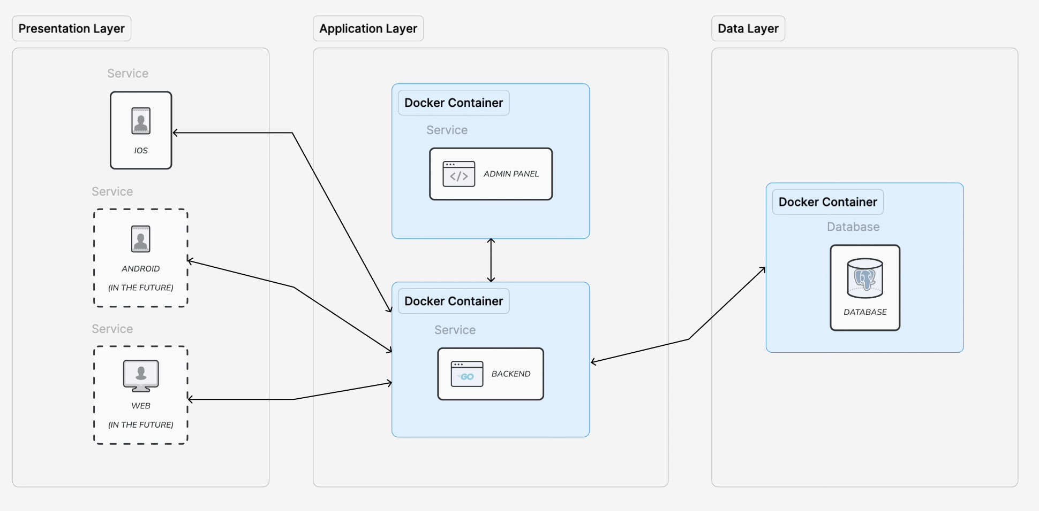
🛠️ System Architecture Diagram
Notes:
Here is the System Architecture Diagram.
It showcases three distinct layers — Presentation, Application, and Data, and the system conforms to the three-tier software architecture pattern.
In the presentation layer, which is directly accessible to users, sits the iOS application written natively using Swift and SwiftUI.
The client applications are intentionally thin, with all business logic and validation living in the backend.
This design avoids trusting the client and keeps all sensitive operations server-side, improving security and maintainability.
The architecture is future-proofed, allowing for the easy introduction of Android and Web clients without changes to the core backend logic.
In the application layer, there are two applications:
a backend service written in Go, which handles all core logic, and
an admin panel implemented as a React web application, which provides controlled interaction with the backend.
The backend exposes RESTful APIs, which are used by all clients to communicate with the system.
Authentication is handled using JWT, and clients store only the minimum data required for session persistence.
In the data layer, a PostgreSQL database is used to store all required system data.
All instances of the application and data layers are already containerized using Docker, which streamlines development and enables horizontal scalability.
Kubernetes and AWS infrastructure are planned for the later stages, as the project moves closer to production deployment.

Slide 3
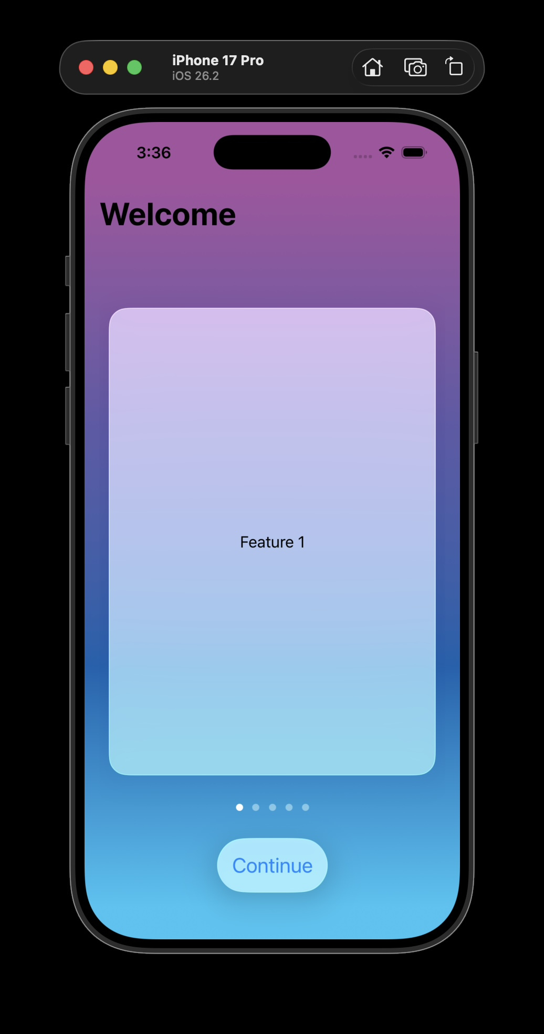
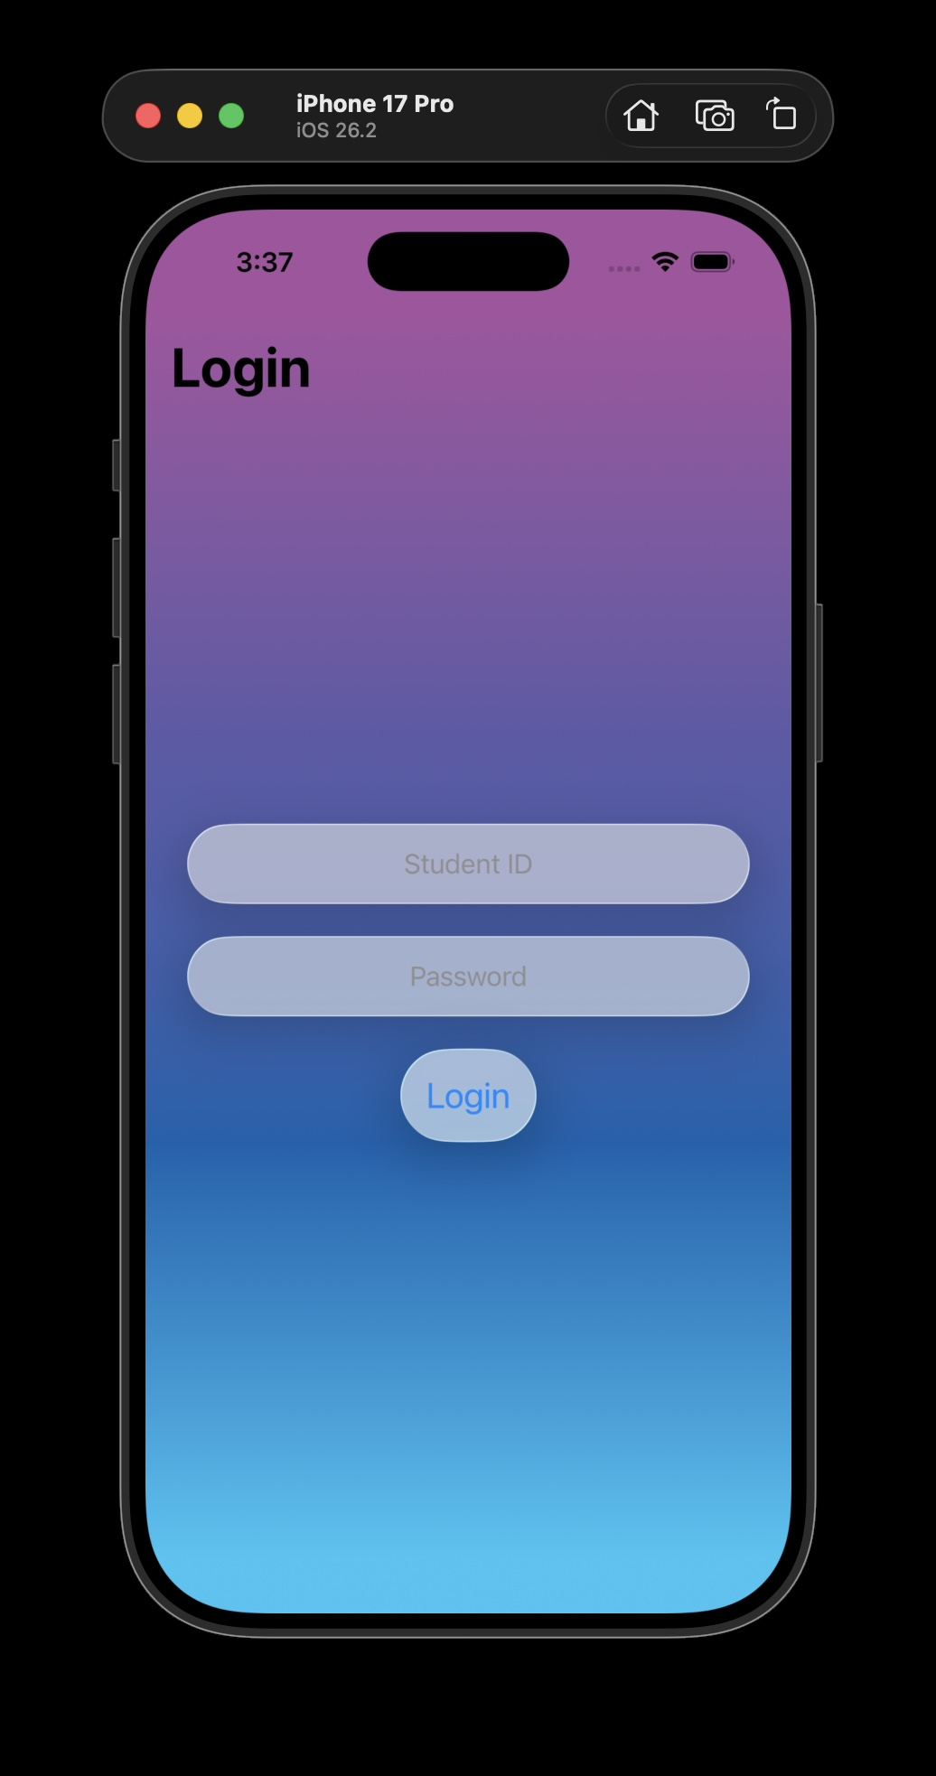
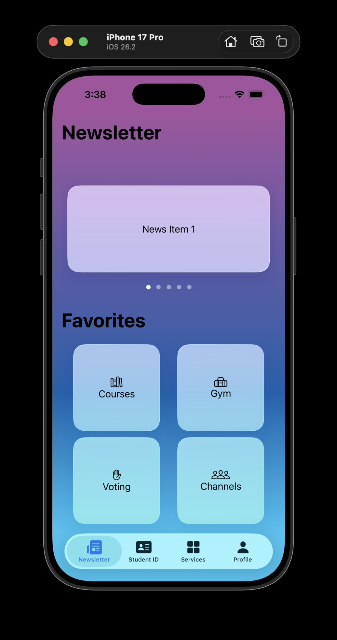
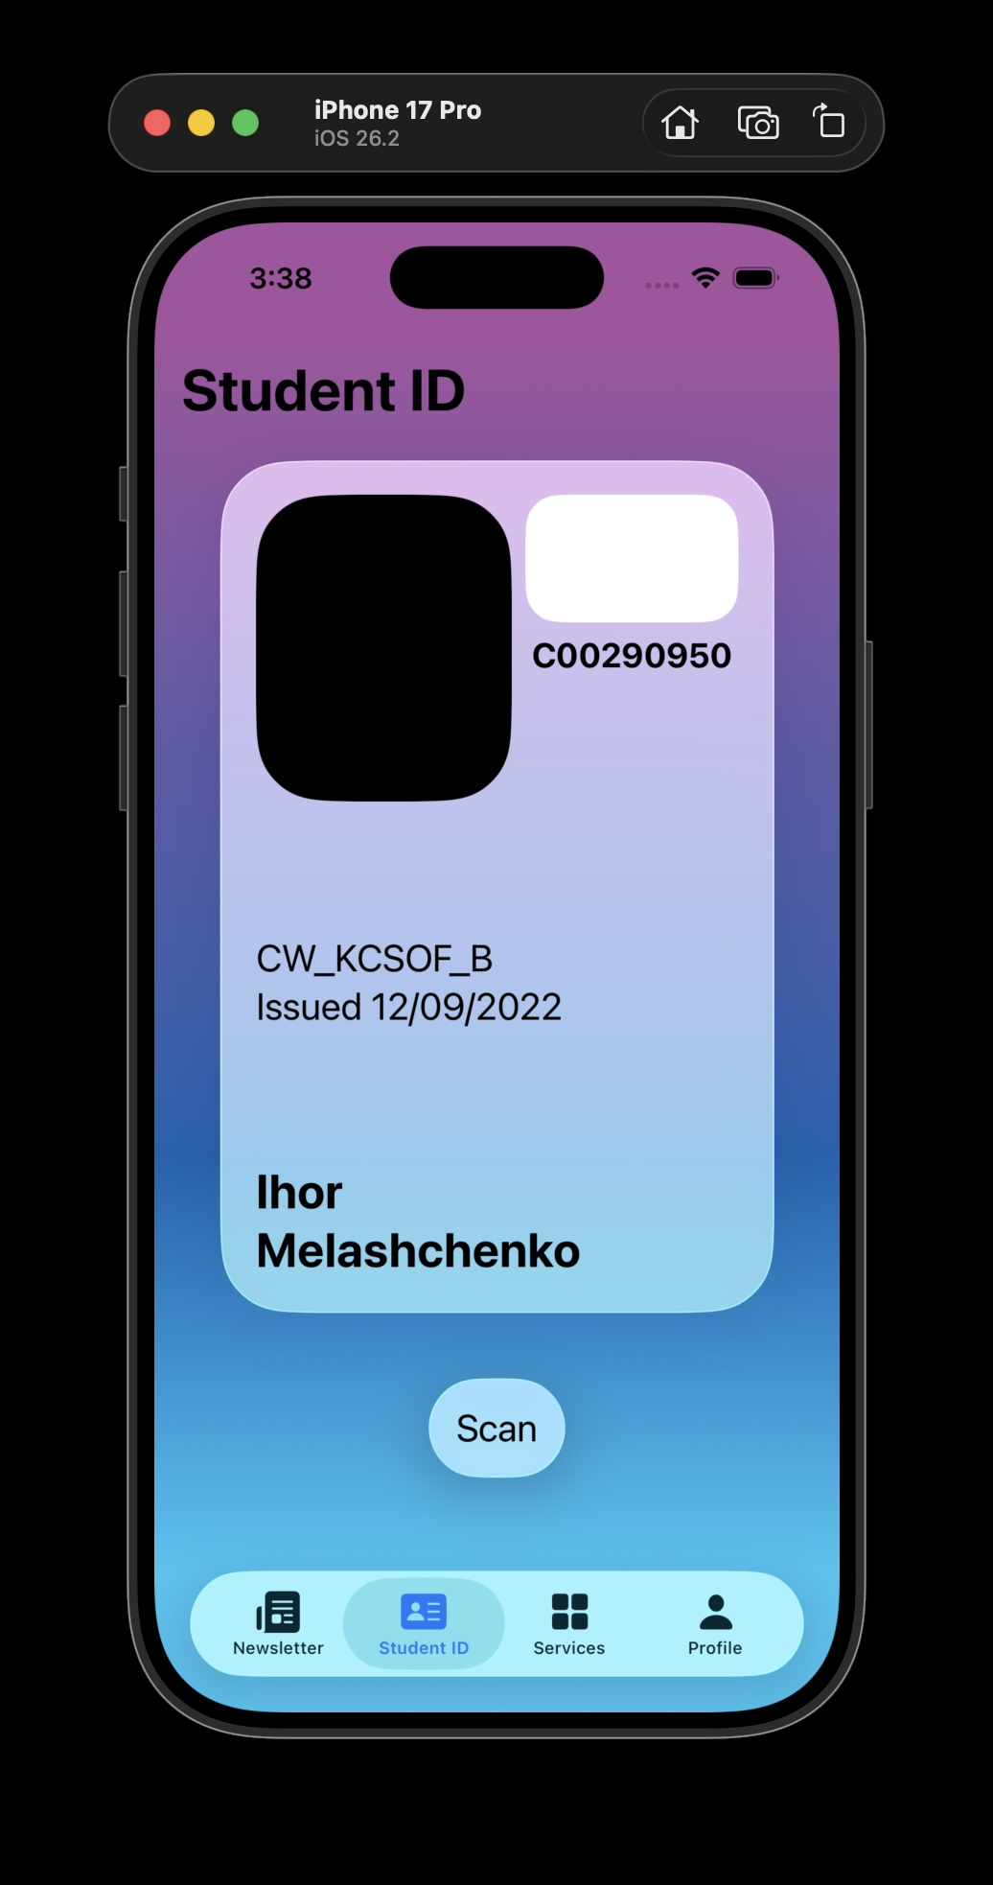
🛠️ iOS Application (Part 1)
Notes:
Here is the iOS application.
As mentioned earlier, it is written natively using Swift and SwiftUI, and it adheres to the Apple Human Interface Guidelines, with support for the new Liquid Glass design style developed by Apple.
The application is built using the MVVM design pattern, which enables a clear separation of concerns between the user interface and application state.
Because the UI is backend-driven, there is minimal business logic on the client, with the application primarily responsible for rendering state received from the backend and handling user interaction.
As shown in the screenshots, the design and implementation of the core features planned for the beta stage are nearly complete.

Slide 4
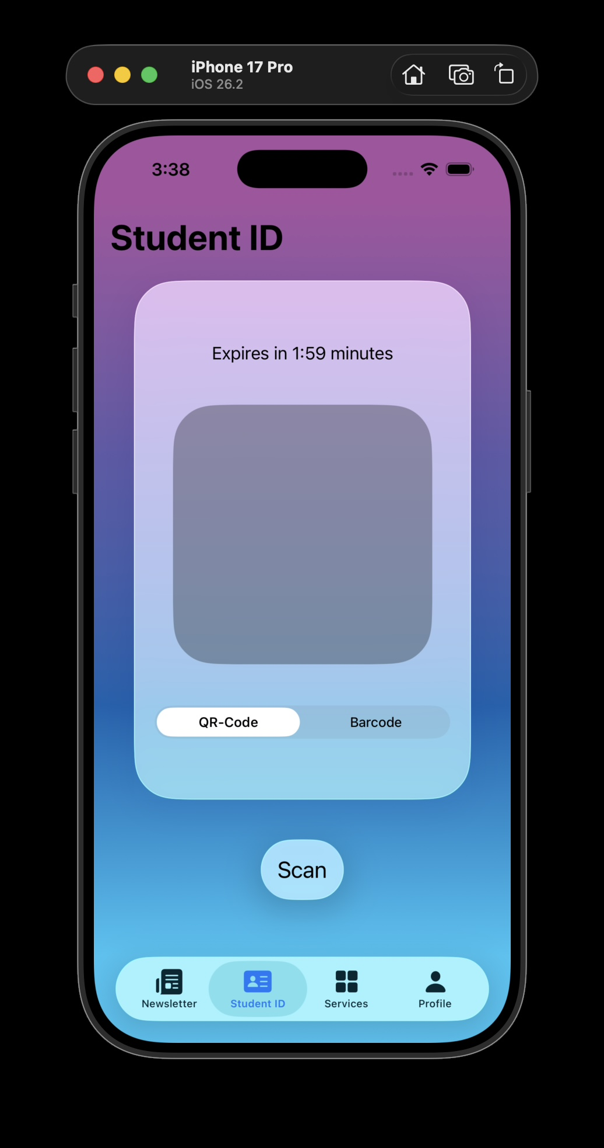
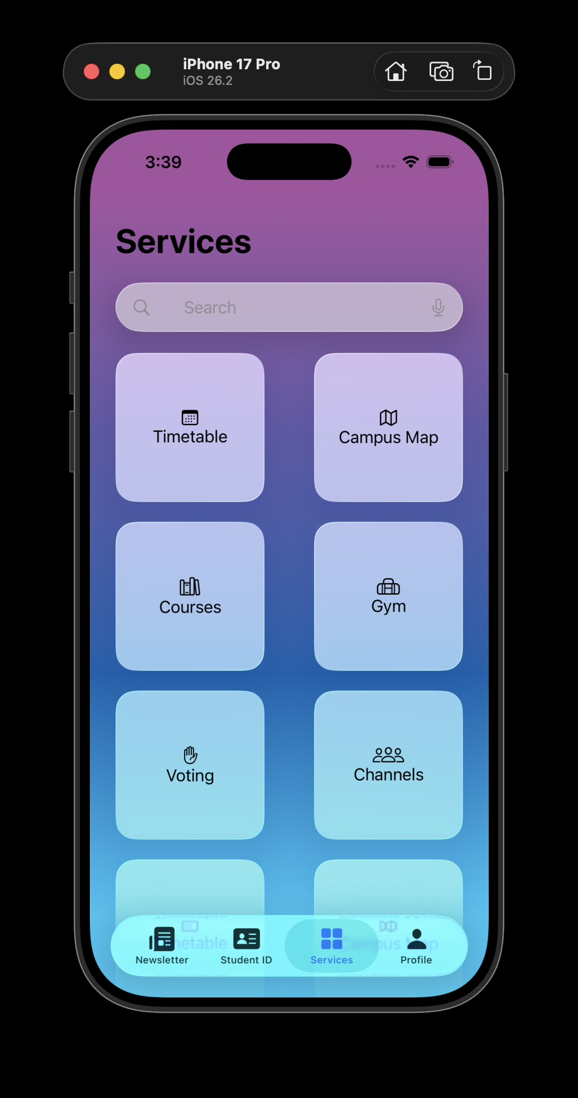
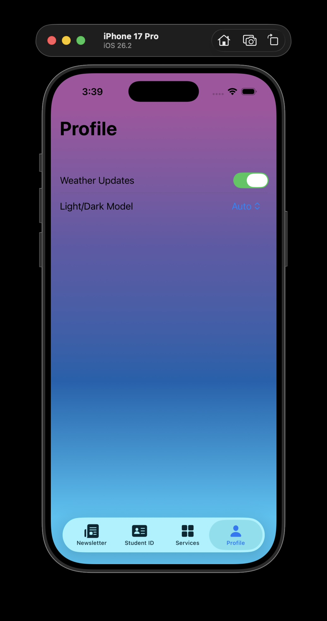
🛠️ iOS Application (Part 2)
Notes:
This slide shows the second part of the iOS application, continuing from the previous slide.
It further demonstrates the implementation of the core beta features and the consistent application of the design system across the app.
No additional architectural concepts are introduced here — this slide simply supports the implementation progress shown previously.

Slide 5
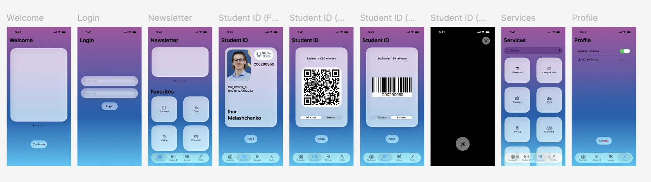
🎨 Mockup (For Reference)
Notes:
This slide shows the prototype I developed earlier, which I showcased in my last presentation.
The prototype was used for early UI validation and to confirm design decisions.
The current application implementation aligns with this prototype, and the focus has now shifted to system correctness and backend development, ensuring the app is robust, secure, and maintainable.

Slide 6
🎯 Milestones
Complete documentation (est. end of January)
Complete backend (est. end of February)
Complete iOS application (est. end of February)
Complete Kubernetes and AWS setup (est. end of March)
Ship to production (est. end of April)
Notes:
This slide outlines the current backend and API status, as well as the remaining project milestones.
From a backend perspective, the foundation of the backend is almost complete.
The API architecture has been developed, and the iOS client is already successfully communicating with the backend, confirming the end-to-end integration.
Looking at the key milestones:
By the end of January, all required project documentation will be completed.
By the end of February, the backend development for all beta-stage features will be finished, and the iOS application will be completed in parallel.
By the end of March, the Kubernetes architecture will be set up and the system will be deployed to AWS.
By the end of April, all remaining features will be finalized, testing completed, and the application deployed to the production environment.

Slide 7
🙏 Thank You!
Any Questions? 🤔
Notes:
Thank you for your attention.
I would be happy to answer any questions or hear your feedback.

